Slide 2
Why you should create your next library using .NET Standard
Carlos dos Santos
CTO, CDS Software
@cdssoftware

Slide 3
This is a great week for .NET…

Slide 4
.NET Core 3 was launched!
But I’m working with .NET 4.0, 4.5, 4.6…
I can’t upgrade all of my code to .NET Core
I have many dependencies
I already run .NET Portability Analyzer and there are many parts of code that are incompatible with .NET Core

Slide 5
How can I use the benefits of .NET Core ?
You have some options:
Rewrite all of your code
Forget every innovations and continue with the same
Create only new projects using .NET Core…
But if you could move some parts of code to .NET Core ?
What do you think about ?

Slide 6
Do you know .NET Standard?

Slide 7
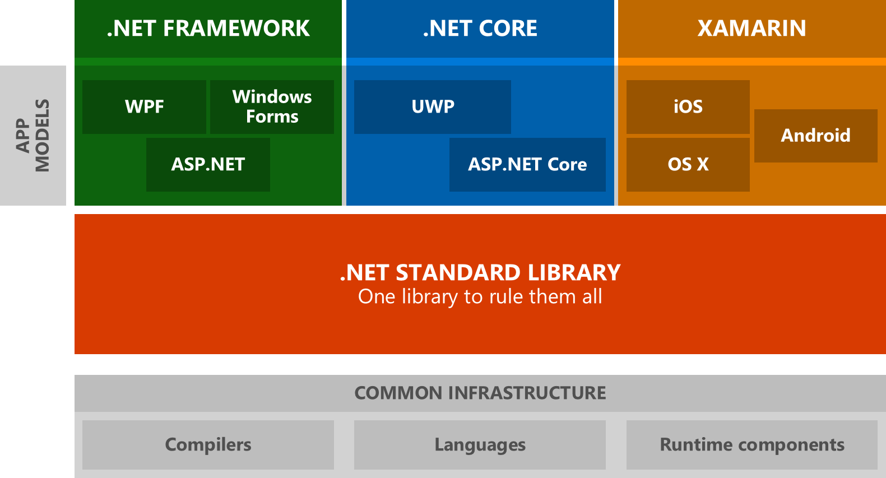
Welcome to .NET Standard

Slide 8
Welcome to .NET Standard
It’s a way to create a standard implementation between .NET Frameworks
With .NET Standard you write code that is compatible between .NET Framework, .NET Core and Xamarin

Slide 9
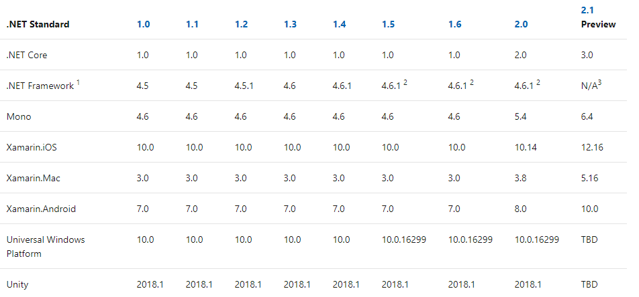
.NET Standard Compatibility
https://docs.microsoft.com/en-us/dotnet/standard/net-standard

Slide 10
.NET Standard Compatibility
https://docs.microsoft.com/en-us/dotnet/standard/net-standard

Slide 11
.NET Standard Compatibility
https://docs.microsoft.com/en-us/dotnet/standard/net-standard

Slide 12
.NET Standard – Your choice…
You can move some parts of code to a .NET Standard Library
And you can use the benefits of .NET Core
Better than this, you are improving your code, moving forward
And now you can write some code using .NET Core, working together with your legacy code

Slide 13
.NET Standard 2.1
Unfortunately, version 2.1, that was used in .NET Core 3 is not compatible with .NET Framework
But version 2.0 is ☺
And you can reference projects that use 2.0 in .NET Core 3
It seems confused right ? But is not !!!

Slide 14
How can I use .NET Standard with my legacy ?
First you need to move .NET Framework version to 4.6.1 (at least – recommended 4.7.2)
Second you can move some classes or code that is compatible with .NET Core (use Portability Analyzer) to a .NET Standard 2.0 project
Finally, you can reference .NET Core Libraries in your .NET Framework project
If you have .NET Core projects, you can reference the same library as well

Slide 15
Write your libraries in .NET Standard!

Slide 16
Writing libraries in .NET Standard
You can use the benefits of .NET Core
Create better code and improve your developer's capabilities, that is great ☺
Keep your legacy code running…
And prepare your company to the future!
Remember that .NET 4.8 is the last version of Full Framework

Slide 17
Demo

Slide 18
Links
https://docs.microsoft.com/en-us/dotnet/standard/net-standard
https://github.com/dotnet/standard
https://devblogs.microsoft.com/dotnet/announcing-net-standard-2-1

Slide 19
Questions?
Carlos dos Santos
CTO, CDS Software
@cdssoftware
www.github.com/carloscds

